Slide 1
Advance Java JSP Technology
Jsp (Java server Pages)

Slide 2
Jsp
JSP technology is used to create web application just like Servlet technology. It can be thought of as an extension to servlet because it provides more functionality than servlet such as expression language, jstl etc.
A JSP page consists of HTML tags and JSP tags. The jsp pages are easier to maintain than servlet because we can separate designing and development. It provides some additional features such as Expression Language, Custom Tag etc.

Slide 3
Advantage of JSP over Servlet
There are many advantages of JSP over servlet. They are as follows:
1) Extension to Servlet
JSP technology is the extension to servlet technology. We can use all the features of servlet in JSP. In addition to, we can use implicit objects, predefined tags, expression language and Custom tags in JSP, that makes JSP development easy.
2) Easy to maintain
JSP can be easily managed because we can easily separate our business logic with presentation logic. In servlet technology, we mix our business logic with the presentation logic.
3) Fast Development: No need to recompile and redeploy
If JSP page is modified, we don't need to recompile and redeploy the project. The servlet code needs to be updated and recompiled if we have to change the look and feel of the application.
4) Less code than Servlet
In JSP, we can use a lot of tags such as action tags, jstl, custom tags etc. that reduces the code. Moreover, we can use EL, implicit objects etc.

Slide 4
Life cycle of a JSP Page
The JSP pages follows these phases:
Translation of JSP Page
Compilation of JSP Page
Classloading (class file is loaded by the classloader)
Instantiation (Object of the Generated Servlet is created).
Initialization ( jspInit() method is invoked by the container).
Reqeust processing ( _jspService() method is invoked by the container).
Destroy ( jspDestroy() method is invoked by the container).
Note: jspInit(), _jspService() and jspDestroy() are the life cycle methods of JSP.

Slide 5
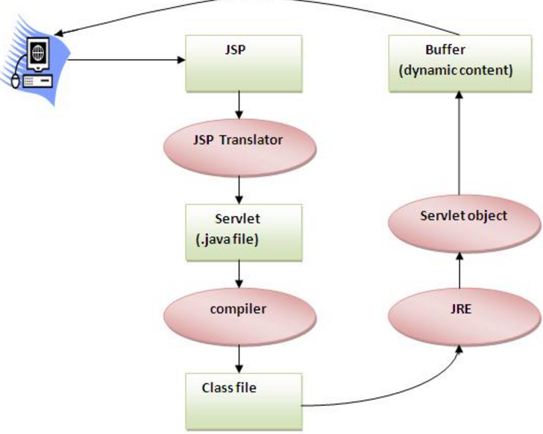
Jsp life cycle
As depicted in the above diagram, JSP page is translated into servlet by the help of JSP translator. The JSP translator is a part of webserver that is responsible to translate the JSP page into servlet. Afterthat Servlet page is compiled by the compiler and gets converted into the class file. Moreover, all the processes that happens in servlet is performed on JSP later like initialization, committing response to the browser and destroy.

Slide 6
Creating a simple JSP Page
To create the first jsp page, write some html code as given below, and save it by .jsp extension. We have save this file as index.jsp. Put it in a folder and paste the folder in the web-apps directory in apache tomcat to run the jsp page.
index.jsp
Let's see the simple example of JSP, here we are using the scriptlet tag to put java code in the JSP page. We will learn scriptlet tag later.
<html>
<body>
<% out.print(2*5); %>
</body>
</html>

Slide 7
How to run a simple JSP Page ?
How to run a simple JSP Page ?
Follow the following steps to execute this JSP page:
Start the server
put the jsp file in a folder and deploy on the server
visit the browser by the url http://localhost:portno/contextRoot/jspfile e.g. http://localhost:8888/myapplication/index.jsp

Slide 8
Do I need to follow directory structure to run a simple JSP ?
No, there is no need of directory structure if you don't have class files or tld files. For example, put jsp files in a folder directly and deploy that folder.It will be running fine.But if you are using bean class, Servlet or tld file then directory structure is required.

Slide 9
Directory structure of JSP
The directory structure of JSP page is same as servlet. We contains the jsp page outside the WEB-INF folder or in any directory.

Slide 10
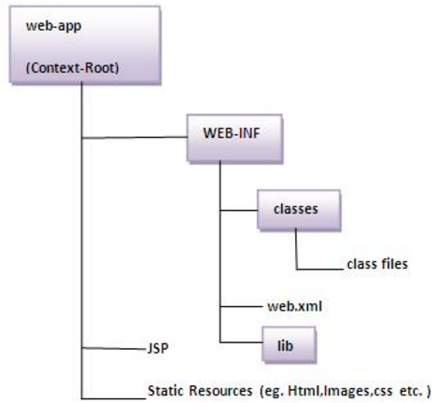
Continue…

Slide 11
The JSP API
The JSP API consists of two packages:
javax.servlet.jsp
javax.servlet.jsp.tagext

Slide 12
javax.servlet.jsp package
The javax.servlet.jsp package has two interfaces and classes.
The two interfaces are as follows:
JspPage
HttpJspPage
The classes are as follows:
JspWriter
PageContext
JspFactory
JspEngineInfo
JspException
JspError

Slide 13
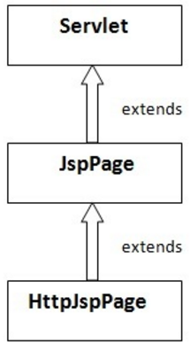
The JspPage interface
According to the JSP specification, all the generated servlet classes must implement the JspPage interface. It extends the Servlet interface. It provides two life cycle methods.

Slide 14
Methods of JspPage interface
public void jspInit(): It is invoked only once during the life cycle of the JSP when JSP page is requested firstly. It is used to perform initialization. It is same as the init() method of Servlet interface.
public void jspDestroy(): It is invoked only once during the life cycle of the JSP before the JSP page is destroyed. It can be used to perform some clean up operation.

Slide 15
The HttpJspPage interface
The HttpJspPage interface provides the one life cycle method of JSP. It extends the JspPage interface.
Method of HttpJspPage interface:
public void _jspService(): It is invoked each time when request for the JSP page comes to the container. It is used to process the request. The underscore _ signifies that you cannot override this method.
We will learn all other classes and interfaces later.

Slide 16
JSP Scriptlet tag (Scripting elements)
In JSP, java code can be written inside the jsp page using the scriptlet tag. Let's see what are the scripting elements first.
JSP Scripting elements
The scripting elements provides the ability to insert java code inside the jsp. There are three types of scripting elements:
scriptlet tag
expression tag
declaration tag

Slide 17
JSP scriptlet tag
A scriptlet tag is used to execute java source code in JSP. Syntax is as follows:
<% java source code %>
Example of JSP scriptlet tag
In this example, we are displaying a welcome message.
<html>
<body>
<% out.print("welcome to jsp"); %>
</body>
</html>

Slide 18
Example of JSP scriptlet tag that prints the user name
In this example, we have created two files index.html and welcome.jsp. The index.html file gets the username from the user and the welcome.jsp
file prints the username with the welcome message.

Slide 19
index.html
<html>
<body>
<form action="welcome.jsp">
<input type="text" name="uname">
<input type="submit" value="go"><br/>
</form>
</body>
</html>

Slide 20
welcome.jsp
<html>
<body>
<%
String name=request.getParameter("uname");
out.print("welcome "+name);
%>
</form>
</body>
</html>

Slide 21
JSP expression tag
The code placed within JSP expression tag is written to the output stream of the response. So you need not write out.print() to write data. It is mainly used to print the values of variable or method.
Syntax of JSP expression tag
<%= statement %>

Slide 22
Example of JSP expression tag
In this example of jsp expression tag, we are simply displaying a welcome message.
<html>
<body>
<%= "welcome to jsp" %>
</body>
</html>
Note: Do not end your statement with semicolon in case of expression tag.

Slide 23
Example of JSP expression tag that prints current time
To display the current time, we have used the getTime() method of Calendar class. The getTime() is an instance method of Calendar class, so we have called it after getting the instance of Calendar class by the getInstance() method.

Slide 24
index.jsp
<html>
<body>
Current Time: <%= java.util.Calendar.getInstance().getTime() %>
</body>
</html>

Slide 25
Example of JSP expression tag that prints the user name
In this example, we are printing the username using the expression tag. The index.html file gets the username and sends the request to the welcome.jsp file, which displays the username.

Slide 26
index.jsp
<html>
<body>
<form action="welcome.jsp">
<input type="text" name="uname"><br/>
<input type="submit" value="go">
</form>
</body>
</html>

Slide 27
welcome.jsp
<html>
<body>
<%= "Welcome "+request.getParameter("uname") %>
</body>
</html>

Slide 28
JSP Declaration Tag
The JSP declaration tag is used to declare fields and methods.
The code written inside the jsp declaration tag is placed outside the service() method of auto generated servlet.
So it doesn't get memory at each request.
Syntax of JSP declaration tag
The syntax of the declaration tag is as follows:
<%! field or method declaration %>

Slide 29
Example of JSP declaration tag that declares field
In this example of JSP declaration tag, we are declaring the field and printing the value of the declared field using the jsp expression tag.
index.jsp
<html>
<body>
<%! int data=50; %>
<%= "Value of the variable is:"+data %>
</body>
</html>

Slide 30
Example of JSP declaration tag that declares method
In this example of JSP declaration tag, we are defining the method which returns the cube of given number and calling this method from the jsp expression tag. But we can also use jsp scriptlet tag to call the declared method.
index.jsp
<html>
<body>
<%!
int cube(int n){
return n*n*n*;
}
%>
<%= "Cube of 3 is:"+cube(3) %>
</body>
</html>

Slide 31
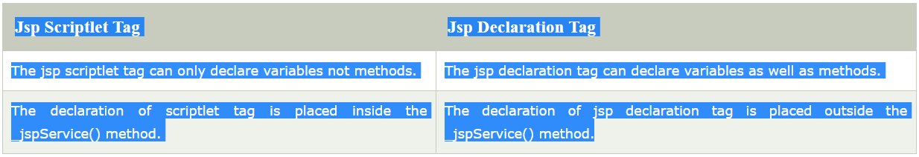
Difference between JSP Scriptlet tag and Declaration tag

Slide 32
JSP Implicit Objects
There are 9 jsp implicit objects. These objects are created by the web container that are available to all the jsp pages.
The available implicit objects are out, request, config, session, application etc.

Slide 33
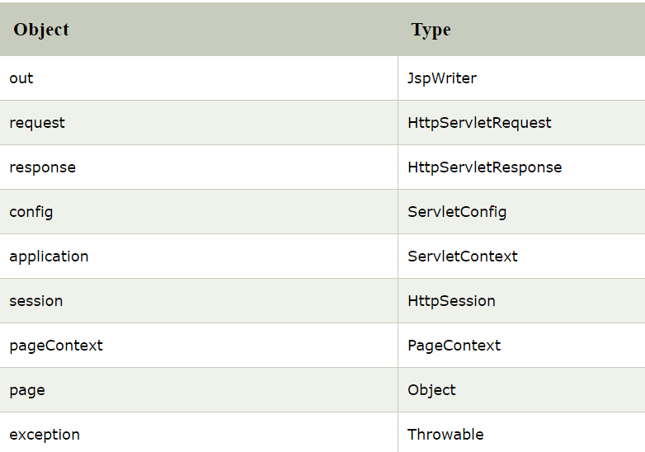
A list of the 9 implicit objects is given below:

Slide 34
1) JSP out implicit object
For writing any data to the buffer, JSP provides an implicit object named out. It is the object of JspWriter. In case of servlet you need to write:
PrintWriter out=response.getWriter();
But in JSP, you don't need to write this code.

Slide 35
Example of out implicit object
In this example we are simply displaying date and time.
index.jsp
<html>
<body>
<% out.print("Today is:"+java.util.Calendar.getInstance().getTime()); %>
</body>
</html>

Slide 36
2)JSP request implicit object
The JSP request is an implicit object of type HttpServletRequest i.e. created for each jsp request by the web container. It can be used to get request information such as parameter, header information, remote address, server name, server port, content type, character encoding etc.
It can also be used to set, get and remove attributes from the jsp request scope.
Let's see the simple example of request implicit object where we are printing the name of the user with welcome message.

Slide 37
Example of JSP request implicit object
index.html
<form action="welcome.jsp">
<input type="text" name="uname">
<input type="submit" value="go"><br/>
</form>
Welcme.jsp
<%
String name=request.getParameter("uname");
out.print("welcome "+name);
%>

Slide 38
3) JSP response implicit object
In JSP, response is an implicit object of type HttpServletResponse. The instance of HttpServletResponse is created by the web container for each jsp request.
It can be used to add or manipulate response such as redirect response to another resource, send error etc.
Let's see the example of response implicit object where we are redirecting the response to the Google.

Slide 39
Example of response implicit object
index.html
<form action="welcome.jsp">
<input type="text" name="uname">
<input type="submit" value="go"><br/>
</form>
Welcome.jsp
<%
response.sendRedirect("http://www.google.com");
%>

Slide 40
4) JSP config implicit object
In JSP, config is an implicit object of type ServletConfig. This object can be used to get initialization parameter for a particular JSP page. The config object is created by the web container for each jsp page.
Generally, it is used to get initialization parameter from the web.xml file.

Slide 41
Example of config implicit object:
index.html
<form action="welcome">
<input type="text" name="uname">
<input type="submit" value="go"><br/>
</form>

Slide 42
web.xml file
<web-app>
<servlet>
<servlet-name>demo</servlet-name>
<jsp-file>/welcome.jsp</jsp-file>
<init-param>
<param-name>dname</param-name>
<param-value>sun.jdbc.odbc.JdbcOdbcDriver</param-value>
</init-param>
</servlet>
<servlet-mapping>
<servlet-name>demo</servlet-name>
<url-pattern>/welcome</url-pattern>
</servlet-mapping>
</web-app>

Slide 43
welcome.jsp
<%
out.print("Welcome "+request.getParameter("uname"));
String driver=config.getInitParameter("dname");
out.print("driver name is="+driver);
%>

Slide 44
5) JSP application implicite object
In JSP, application is an implicit object of type ServletContext.
The instance of ServletContext is created only once by the web container when application or project is deployed on the server.
This object can be used to get initialization parameter from configuaration file (web.xml). It can also be used to get, set or remove attribute from the application scope.
This initialization parameter can be used by all jsp pages.

Slide 45
index.html
<form action="welcome">
<input type="text" name="uname">
<input type="submit" value="go"><br/>
</form>

Slide 46
web.xml file
<web-app>
<servlet>
<servlet-name>welcome</servlet-name>
<jsp-file>/welcome.jsp</jsp-file>
</servlet>
<servlet-mapping>
<servlet-name>welcome</servlet-name>
<url-pattern>/welcome</url-pattern>
</servlet-mapping>
<context-param>
<param-name>dname</param-name>
<param-value>sun.jdbc.odbc.JdbcOdbcDriver</param-value>
</context-param>
</web-app>

Slide 47
welcome.jsp
<%
out.print("Welcome "+request.getParameter("uname"));
String driver=application.getInitParameter("dname");
out.print("driver name is="+driver);
%>

Slide 48
6) session implicit object
In JSP, session is an implicit object of type HttpSession.The Java developer can use this object to set,get or remove attribute or to get session information.
Example of session implicit object

Slide 49
index.html
<html>
<body>
<form action="welcome.jsp">
<input type="text" name="uname">
<input type="submit" value="go"><br/>
</form>
</body>
</html>

Slide 50
welcome.jsp
<html>
<body>
<%
String name=request.getParameter("uname");
out.print("Welcome "+name);
session.setAttribute("user",name);
<a href="second.jsp">second jsp page</a>
%>
</body>
</html>

Slide 51
second.jsp
<html>
<body>
<%
String name=(String)session.getAttribute("user");
out.print("Hello "+name);
%>
</body>
</html>

Slide 52
7) pageContext implicit object
In JSP, pageContext is an implicit object of type PageContext class.The pageContext object can be used to set,get or remove attribute from one of the following scopes:page
request
session
application
In JSP, page scope is the default scope.

Slide 53
Example of pageContext implicit object
index.html
<html>
<body>
<form action="welcome.jsp">
<input type="text" name="uname">
<input type="submit" value="go"><br/>
</form>
</body>
</html>

Slide 54
welcome.jsp
<html>
<body>
<%
String name=request.getParameter("uname");
out.print("Welcome "+name);
pageContext.setAttribute("user",name,PageContext.SESSION_SCOPE);
<a href="second.jsp">second jsp page</a>
%>
</body>
</html>

Slide 55
second.jsp
<html>
<body>
<%
String name=(String)pageContext.getAttribute("user",PageContext.SESSION_SCOPE);
out.print("Hello "+name);
%>
</body>
</html>

Slide 56
8) exception implicit object
In JSP, exception is an implicit object of type java.lang.Throwable class. This object can be used to print the exception. But it can only be used in error pages.It is better to learn it after page directive. Let's see a simple example:

Slide 57
Example of exception implicit object:
index.jsp for input values
process.jsp for dividing the two numbers and displaying the result
error.jsp for handling the exception

Slide 58
index.jsp
<form action="process.jsp">
No1:<input type="text" name="n1" /><br/><br/>
No1:<input type="text" name="n2" /><br/><br/>
<input type="submit" value="divide"/>
</form>

Slide 59
process.jsp
<%@ page errorPage="error.jsp" %>
<%
String num1=request.getParameter("n1");
String num2=request.getParameter("n2");
int a=Integer.parseInt(num1);
int b=Integer.parseInt(num2);
int c=a/b;
out.print("division of numbers is: "+c);
%>

Slide 60
error.jsp
<%@ page isErrorPage="true" %>
<h3>Sorry an exception occured!</h3>
Exception is: <%= exception %>

